Slide 1
3. HCS12 Hardware
Learning Objectives
basics of HCS 12 architecture
register set and programmers model
addressing modes
reset
SECTIONS
3.1 HCS12 Microcontroller
3.2 CPU & Registers
3.3 HCS12 Operating Modes
3.5 Memory Map
3.6 Addressing Modes
3.7 Reset

Slide 2
3.1 HCS12 Microcontroller
high density complimentary metal oxide semiconductor (HCMOS) circuit
widely used in automotive and embedded applications
CPU is useful basic learning tool due to its rich register set and vectored interrupts
CPU characteristics
16 bit data bus
16 bit address (2¹⁶ addressable memory)
possible to expand memory using alternate configuration
Memory
Addr
Data
$4000 | xxxxxxxx
$4001 | xxxxxxxx
$4002 | xxxxxxxx
$4003 | xxxxxxxx
CPU components
CPU registers
timer services
ALU
On Board Flash/RAM
Input/Output Ports
A 16
D 16
ALU
registers
I/O
timers

Slide 3
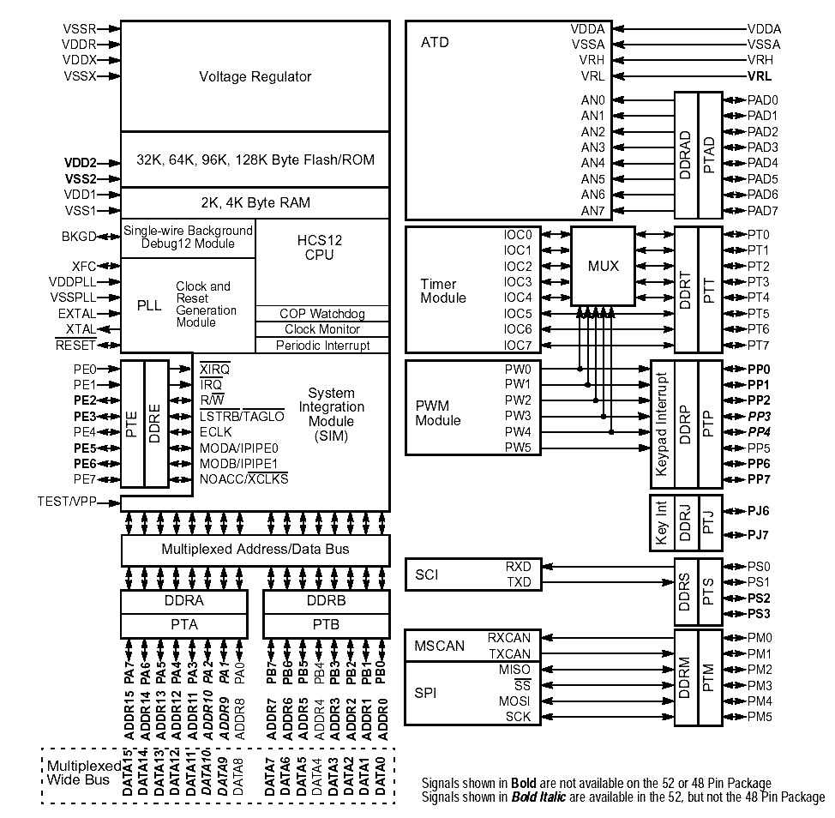

Slide 4
Microcontroller Components
I/O supported by HCS12
Analog to Digital Converter
Parallel I/O Ports
SCI Serial Bus
SPI Serial Bus
CAN Bus
Vectored Interrupt Support for 128 Interrupt Types
I/O support: CAN, Parallel Ports, A/D, SPI….
Timers
External Interrupts
Internal Failures

Slide 5
3.2 CPU & Registers
Programmers CPU Model
registers for control of operations
registers to determine status of operations
registers that contain data
registers to support addressing modes
(1) Accumulators
(2) Index Registers
(3) Stack Pointer
(4) Program Counter
(5) Condition Code Register
(6) Control Registers

Slide 6
(1) Accumulators
two 8 bit accumulators (A and B) known as A and B
stores operands for 8 bit operations
each can be a source or destination of an operand
operand for A
7 | 6 | 5 | 4 | 3 | 2 | 1 | 0
operand for B
7 | 6 | 5 | 4 | 3 | 2 | 1 | 0
D (accumulator D) is used for 16 bit instructions
use both register A & B as a single 16 bit accumulator
A is MSB
B is LSB
instructions that modify D modify A & B
operand for D
15 | 14 | 13 | 12 | 11 | 10 | 9 | 8 | 7 | 6 | 5 | 4 | 3 | 2 | 1 | 0

Slide 7
(2)Index Registers
Two 16 bit index registers – Index Register X and Y
primarily used for indexed addressing
some arithmetic instructions also use index registers
memory
X
data 0
data 1
data 2
data 3
address of data 0
15 | 14 | 13 | 12 | 11 | 10 | 9 | 8 | 7 | 6 | 5 | 4 | 3 | 2 | 1 | 0
Y
15 | 14 | 13 | 12 | 11 | 10 | 9 | 8 | 7 | 6 | 5 | 4 | 3 | 2 | 1 | 0

Slide 8
(3) Stack Pointer
Program Stack is Last-In-First-Out (LIFO) Data Structure in Memory used to store values
The newest (last) data entry will be the first data entry accessed
Stack Pointer (SP) keeps track of the stack
memory
Stack Pointer
pushed data
pushed data
pushed data
pushed data
address of next available location
15 | 14 | 13 | 12 | 11 | 10 | 9 | 8 | 7 | 6 | 5 | 4 | 3 | 2 | 1 | 0
stack
HCS 12 maintains pointer to program stack in RAM
must be initialized to point to RAM base
always points (contains address) of next memory location for PUSH operation
automatically decremented when pushing data onto stack
automatically incremented when removing data from the stack

Slide 9
Stack grows downwards in memory
SP points to next empty byte used to store data
Stack PUSH – store data in memory → SP is automatically adjusted to the next available location (decremented)
Stack PULL – remove data from the stack → SP is automatically adjusted to moved to the data’s memory location (incremented) , data is retrieved
STACK
Address | Data
2604
2605
2606 | $FF
2607 | $DA
2608 | $34
SP
2605

Slide 10
(4) Program Counter
points (contains address) to next instruction to execute
no direct manipulation by user
memory
next instruction
Program counter
address of next instruction
15 | 14 | 13 | 12 | 11 | 10 | 9 | 8 | 7 | 6 | 5 | 4 | 3 | 2 | 1 | 0

Slide 11
(5) Condition Code Register
S | X | H | I | N | Z | V | C
7 | 6 | 5 | 4 | 3 | 2 | 1 | 0
Bits that indicate result of operations
C = carry bit: set if carry or borrow occurs
V = overflow bit: set if 2’s compliment overflow occurs
Z = zero bit: set if operation results in 0
N = set if msb of result is set
H = ½ carry: set if carry or borrow out of bit 3 – used by decimal adjust for addition instructions
C, V, Z, N bits are set/reset during operations by the CPU
CPU control bits
I = interrupt mask
X = X-interrupt mask
S = stop disable
I, X, S are set in code by the programmer

Slide 12
(6) Control Registers
1024 memory locations at $0000 - $03FF
bits control different parts of microcontroller
Register Classification
registers that are set to make HCS12 perform actions
registers that are read to determine status of actions
data registers to move data to and from for I/O devices

Slide 13
Examples of Control Registers
COP Control Register controls COP RESET
mnemonic: COPCTL
address: $003C
BIT | 7 | 6 | 5 | 4 | 3 | 2 | 1 | 0
Read | WCOP | RSBCK | 0 | 0 | 0 | CR2 | CR1 | CR0
Write
Reset value | 1 | 1 | 1 | 1 | 0 | 0 | 0 | 1
Reserved, not implemented, or cannot be written to
COPCTL Register ($003C) description
bit | mne | description
7 | WCOP | enabled windowed COP operation
6 | RSBCK | COP & RTI stop in active BDM mode
5 | 0
4 | 0
3 | 0
2 | CR2 | Watchdog Timer Select Rate
1 | CR1
0 | CR0

Slide 14
3.3 HCS12 Operating Modes
On RESET → HCS12 Operating Mode is determined by three signals
Assume we are Using Normal Single Chip Mode
Other modes allow background debuggers (BDMs), external memory support, and special testing

Slide 15
3.5 Memory Map
HCS12 supports up to 64KB of onboard memory
Configuration of Memory varies for different HCS12 models
MC9S12C32
$0000
Control Register Space
$03FF
Reserved
$0800
RAM
$0FFF
Reserved
$8000
Flash
$FF00
Int. Vectors
$FFFF

Slide 16
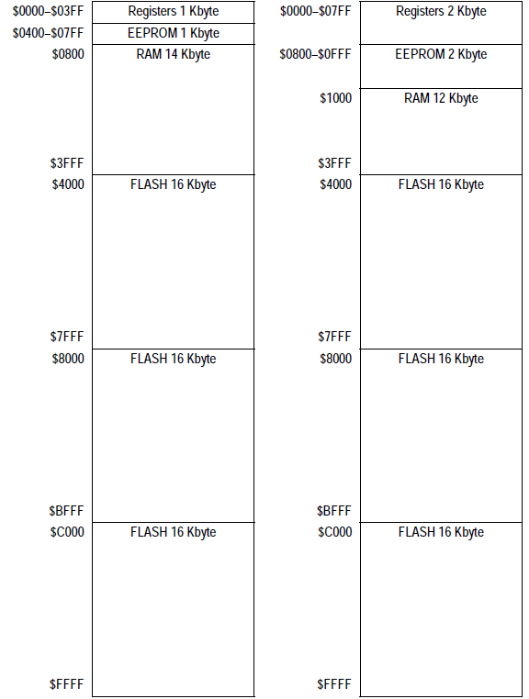
default memory maps for
9S12XDP512 (right)
9S12DP512 (left)

Slide 17
3.6 Addressing Modes
methods for accessing memory and I/O locations
Types of Addressing Modes
(1) Immediate Addressing Mode
(2) Direct and Extended Addressing Mode
(3) Indexed Addressing
(3.1) constant
(3.2) automatic adjust
(3.3) accumulator
(3.4) indirect
(4) Inherent Addressing Mode
(5) Relative Addressing

Slide 18
(1) Immediate Addressing Mode
data for an instruction immediately follows the opcode
used to initialize registers with known constants
instruction format is: Operation #data
# indicates immediate addressing →CPU loads operand directly as data
if # is not used → operand is treated as an address - CPU loads data at memory location specified by operand
example:
A
$40
LDAA | #$40
Line | Addr | Code | LABEL | OPCODE | OPERAND | COMMENT
0001 | 0000 | 86 40 |  | LDAA | #$40 | load $40 into A
0002 | 0002 | 86 40 |  | LDAA | #64 | load 64 into A
0003 | 0004 | CE 12 34 |  | LDX | #$1234 | load $1234 into X

Slide 19
(2) Direct and Extended Addressing Mode
Direct Addressing (aka base page or reduced direct addressing)
instructions has 8-bit address used to read from or write to
instruction provides LSB and CPU sets MSB to $00
can access address range $0000 to $00FF (256 locations)
Extended Addressing
instruction has 16-bit address used to read from or write to
can access address range from $0000 to $FFFF (2¹⁶ locations)
Notation:
($XXXX) indicates data contents of address location $XXXX
($XXXX) = xx
memory
address | data
$XXXX | xx

Slide 20
Direct Addressing
Line | Addr | Code | LABEL | OPCODE | OPERAND | COMMENT
0001 | 0000 | 96 FF |  | LDAA | $FF | load ($FF) into A
0002 | 0002 | 5B FF |  | STAB | 255 | load B into (255)
0003 | 0004 | DE 0A |  | LDX | 10 | load $(000A:000B) into X
8 bit data operation
memory
address | data
$00FF | xx
A
xx
memory
address | data
$00FF | xx
B
xx
16 bit data operation
memory
address | data
$000A | xx
$000B | yy
X
xxyy

Slide 21
Extended Addressing
Line | Addr | Code | LABEL | OPCODE | OPERAND | COMMENT
0001 | 0000 | B6 23 45 |  | LDAA | $2345 | load ($FF) into A
0002 | 0003 | 7B 43 21 |  | STAB | $4321 | load B into (255)
0003 | 0006 | FE C002 |  | LDX | $C002 | load $(C002:C003) into X
8 bit data operation
memory
address | data
$2345 | xx
A
xx
memory
address | data
$4321 | xx
B
xx
16 bit data operation
memory
address | data
$C002 | xx
$C003 | yy
X
xxyy

Slide 22
(3) Indexed Addressing Mode
used to access elements in an array or data structure
index registers contains base address of data
offset value added to access other elements
memory
address | data
$00FA | vv
$00FB | xx
$00FC | cc
base addr
X
$00FA
data being accessed
offset = 2
Index Registers can be X, Y, SP, PC
Optional automatic pre/post Index Register increment and decrement
Offset Modes
(3.1) Indexed Addressing – Constant Offset
(3.2) Automatic Index increment or decrement
(3.3) Indexed Addressing - Accumulator Offset
(3.4) Indexed Indirect Addressing

Slide 23
(3.1) Indexed Addressing Mode using Constant Offset
offset value is a Constant
instruction format is: Operation offset, IndexRegister
offset = signed 5, 9, 16 bit value
address of data = (X) + offset
offset range
-16 to 15 | 5 bit signed offset
-256 to 255 | 9 bit signed offset
-32768 to 32767 | 16 bit signed offset
Addition of offset:
addition specifies the effective address
addition does not change the contents of Index Register

Slide 24
access an array with four 8-bit data elements
vv
xx
yy
zz
Operation 3, X
memory
address | data
$00F9 | uu
$00FA | vv
$00FB | xx
$00FC | yy
$00FD | zz
$00FE | cc
X
$00FA
base addr of data structure
offset = 3
data being accessed

Slide 25
Indexed Addressing Mode – Constant Offset examples
Line | Addr | Code | LABEL | OPCODE | OPERAND | COMMENT
0001 | 0000 | A6 00 |  | LDAA | 0,X | load (X+0) into A
memory
address | data
$00E0 | vv
X
$00E0
A
vv
offset = 0
Line | Addr | Code | LABEL | OPCODE | OPERAND | COMMENT
0002 | 0002 | A6 1E |  | LDAA | 30,X | load (X + 30) into A
memory
address | data
$00E0 | vv
…. | ….
$00FE | zz
$00FF | cc
X
$00E0
A
zz
offset = 30

Slide 26
Indexed Addressing Mode – Constant Offset examples
16 bit operation
Line | Addr | Code | LABEL | OPCODE | OPERAND | COMMENT
0003 | 0004 | EC 1E |  | LDD | 30,X | load (X+30), (X+31) into D
memory
address | data
$00E0 | vv
…. | ….
$00EC | yy
$00FE | zz
$00FF | cc
X
$00E0
D
zzcc
offset = 30
16 bit operation affects data at
00FE: effective address
00FF: effective address + 1

Slide 27
(3.2) Automatic Index Adjustment
Index Register is automatically adjusted during instruction execution
Used to manage data structures
first in first out (FIFO)
last in first out (LIFO)
IndexRegister can be incremented or decremented
pre-adjustment: adjust (IndexRegister) before accessing Effective Address
post-adjustment: adjust (IndexRegister) after accessing Effective Address

Slide 28
pre decrement instruction format: Operation offset, -IndexRegister
offset range = 1 to 8
effective address of memory accessed = (X) - offset
pre increment instruction format: Operation offset, +IndexRegister
offset range = 1 to 8
effective address of memory accessed = (X) + offset
post decrement instruction format: Operation offset, IndexRegister-
offset range = 1 to 8
effective address of memory accessed = (X)
(X) decremented by offset after memory access
post increment instruction format: Operation offset, IndexRegister+
offset range = 1 to 8
effective address of memory accessed = (X)
(X) incremented by offset after memory access

Slide 29
Indexed Addressing using Automatic Pre Decrement - example
LABEL | OPCODE | OPERAND | COMMENT
 | LDAB | 2,-X | load (X-2 ) into B
1. before execution
memory
address | data
$C0FE | ww
$C0FF | yy
$C100 | zz
X
$C100
memory
address | data
$C0FE | ww
$C0FF | yy
$C100 | zz
B
ww
X
$C0FE
2. pre decrement (X)
3. access memory

Slide 30
Indexed Addressing using Automatic Pre Increment - example
LABEL | OPCODE | OPERAND | COMMENT
 | STAB | 1,+X | load B into (X+1)
1. before execution
memory
address | data
$C0FE | ww
$C0FF | yy
$C100 | zz
X
$C0FE
memory
address | data
$C0FE | ww
$C0FF | aa
$C100 | zz
2. pre increment (X)
B
aa
X
$C0FF
3. access memory

Slide 31
Indexed Addressing using Automatic Post Increment - example
LABEL | OPCODE | OPERAND | COMMENT
 | STAB | 2, X+ | load B into (X) then increment (X)
1. before execution
memory
address | data
$C100 | aa
$C101 | yy
$C102 | zz
X
$C100
B
aa
2. access memory
memory
address | data
$C100 | aa
$C101 | yy
$C102 | zz
3. post increment (X)
X
$C102

Slide 32
Indexed Addressing using Automatic Post Decrement - example
LABEL | OPCODE | OPERAND | COMMENT
 | LDAA | 1, X- | load (X) into A then decrement (X)
1. before execution
memory
address | data
$C100 | aa
$C101 | yy
$C102 | zz
A
yy
X
$C101
2. access memory
3. post decrement (X)
memory
address | data
$C100 | aa
$C101 | yy
$C102 | zz
X
$C100

Slide 33
(3.3) Indexed Addressing using Accumulator as Offset
instruction format is:
Operation Accumulator , IndexRegister
Effective Address = (index register) + (accumulator)
Index Register: X, Y, SP, PC
Accumulator: A, B, D
value in the index register is not changed
value in the accumulator can be changed to change the effective address
offset is unsigned 8 or 16 bit value stored in accumulator
offset range can be 0 to 255 or 0 to 2¹⁶ - 1

Slide 34
Indexed Addressing using Accumulator as Offset - example
LABEL | OPCODE | OPERAND | COMMENT
 | LDAB | A, X | load (X) + (A) into B
memory
address | data
$C0E0 | vv
…. | ….
$C0E9 | yy
$COEA | zz
$C0AB | cc
A
$0A
X
$C0E0
B
zz
offset = 10

Slide 35
Using Accumulator for a ‘for’ loop - example
LABEL | OPCODE | OPERAND | COMMENT
 | LDAA | #8 | initialize counter
LOOP | LDAB | A, X | load (X) + (A) into B; LABEL is a logical reference point
 | … | … | do something with the data
 | DECA |  | decrement counter
 | BNE | LOOP | if (A) ≠ 0 then branch to LOOP
memory
address | data
$C0E0 | vv
…. | ….
$C0E7 | yy
$COE8 | zz
$C0A9 | cc
A
$08
X
$C0E0
B
zz
offset

Slide 36
(3.4) Indexed-Indirect Indexed Addressing
indirect addressing using either
(1) 16 bit constant
(2) contents of D
indirect means the address of the target data is held in memory
instruction format using 16 bit constant is:
Operation [offset, index register]
instruction format using register D is:
Operation [D, index register]

Slide 37
Indexed-Indirect Indexed Addressing Example – 16 bit offset
LABEL | OPCODE | OPERAND | COMMENT
 | LDX | #$C000 | (X) = $C000
 | LDAB | [$32,X] | (B) = ((C032))
memory
address | data
$C000 | aa
…. | ….
$C031 | yy
$CO32 | C3
$C033 | FF
…. | ….
$C3FF | $0A
X
$C000
B
$0A

Slide 38
Indexed-Indirect Indexed Addressing Example - D
LABEL | OPCODE | OPERAND | COMMENT
 | LDX | #$C000 | (X) = $C000
 | LDD | #$32 | (D) = ($32)
 | STAB | [D,X] | ( ($C032)) =(B)
memory
address | data
$C000 | aa
…. | ….
$CO32 | C4
$C033 | EF
…. | ….
$C4EF | $0A
D
$32
X
$C000
B
$0A

Slide 39
(4) Inherent Addressing Mode
data for the instruction are in the CPU registers
no memory access
set specific values or transfer values between registers
OPCODE | OPERAND | COMMENT
ABA |  | (A) ← (A) + (B)
register | data
A | 0F
B | 01
register | data
A | 10
OPCODE | OPERAND | COMMENT
SEC |  | (C) ← 1
CCR register
 |  |  |  |  |  |  | 1
S | X | H | I | N | Z | V | C
C = carry flag in CCR register

Slide 40
more inherent address mode instructions
Line | Addr | Code | LABEL | OPCODE | OPERAND | COMMENT
0001 | 0000 | 1B |  | ABA |  | (A) ← (A) + (B)
0002 | 0001 | 08 |  | INX |  | (X) ← (X)+1
0003 | 0002 | 0D |  | SEC |  | (C) ← 1
0004 | 0003 | 16 |  | TAB |  | (B) ← (A)

Slide 41
(5) Relative Addressing Mode
Branch/Loop instructions use relative addressing
assembler calculates branch instruction offset based on branch label
offsets are added to next address after PC
If offset = 0 → CPU executes instruction following branch instruction
Offsets for Relative Addressing are 8-bit, 9-bit, and 16-bit values
signed two’s complement numbers
support up/down branches in memory
short branch uses 8 bit offset that ranges from -128 to 127
loop primitive uses 9-bit offset that ranges from –256 to 255
long branch uses 16 bit offset that ranges from–32,768 to 32,767
Jump instructions uses extended or indexed addressing

Slide 42
Conditional Branch - example
LABEL | OPCODE | OPERAND | COMMENT
 | CMPA | #$FF | compare contents of ACCA to #$FF
 | BEQ | LABEL1 | branch to LABEL1 if equal
 | JMP | LABEL2 | jump to label 2 if not equal
LABEL1 | TAB ….
LABEL2

Slide 43
Branches result in exclusive instruction threads
instruction
compare condition
instruction B0
instruction A0
instruction B1
instruction A1
instruction C0

Slide 44
3.7 Reset
CPU can be RESET to recover from fault conditions
incorrect voltage applied
clock malfunctions
program locks up
RESET_L pin: active low pin that is asserted to reset the CPU
internal registers & control bits are forced to initial state, CPU registers and stack pointer must be initialized
after RESET → vector fetched from FFFE : FFFF – address of first instruction to execute after reset
Reset from clock oscillator malfunction
after RESET, CPU fetches a vector from $FFFC-$FFFD as 1st instruction
address can be used to store code to handle oscillator issues
COP watch dog timer generates a reset if its timer times out
break out of locked up code (e.g. infinite loops, resource conflict)
after RESET CPU fetches vector from $FFFA-$FFFB as 1st instruction
address can be used to store code to handle watch dog time outs

Slide 45
Reset Circuit
active low RESET pin is signaled manually or by incorrect voltage levels
CPU fetches vector from address $FFFE:$FFFF as 1st instruction executed after RESET
$FFFE:$FFFF must be ROM/contain 1st instruction to execute on RESET
HC12 RESET Circuit is required for safe operation
requires RESET to be held low if V_{DD} is below proper voltage level
provides power on reset
V_{DD}
IN
R₁
MC 34064
R
RESET
GND
To RESET
Manual Reset
R₂
C
IN
MC 34064
RESET
MC34064 under voltage sensing circuit
GND

Slide 46
RESET Actions
internal registers and control bits are forced to initial state
stack pointer and CPU registers are indeterminate (must be initialized)
set CCR bits I, X, S
1st 256B allocated to RAM
Parallel I/O lines are configured as high-impedance inputs - avoid connecting two outputs
Mod A/ModB pins set operating mode
timer system is reset
interrupt flags are cleared
interrupt system, serial I/O, and analog-digital conversion is disabled
programs should always properly initialize all registers, subsystems – do not assume values are set as you would like them!

